Slide 1

Department of Mathematics Jain Global campus, Jakkasandra Post, Kanakapura Taluk, Ramanagara District -562112
Mathematics-I
Prof.Veeresh Malagi
Department of Mathematics,
FET, Jain(Deemed-to-be-University)

Slide 2
Contents
Syllabus
Learning Objectives
Course Outcomes (CO)
Program Outcomes (PO)
CO-PO Mapping
Targets
Assessment Process

Slide 3
Syllabus
Course Name: Calculus, Differential equation and Linear Algebra
Credits: 4 | Course Code: 18BS1MA01 | Total Contact hours: 45+15
L-T-P : 3-1-0 |  | Contact Hours/week : 04
IA Max Marks : 30 |  | SEE Max Mark: 70
Subject Type : Core

Slide 4
Continued….
Module 1
Time Duration: 11 hours
Calculus: Rolle’s Theorem, Lagrange’s and Cauchy’s Mean value theorems, Taylor’s & MacLaurin’s series for a function of one variable, Evaluation of indeterminate forms by L'Hospital's rule.

Slide 5
Continued…
Module 2
Time Duration: 13 hours
Matrices: Rank of a matrix, Echelon form, System of linear equations: Consistency, solution by Gauss elimination and Gauss - Siedel methods, Eigen values and Eigen vectors of square matrices, Diagonalization of square matrices. Conversion of an n^{th} order differential equation to a system of first order linear differential equations, Solution of system of linear differential equations by diagonalization method and discuss the stability of the system.

Slide 6
Continued…
Module 3
Time Duration: 11 hours
Calculus : Reduction formulae (without proof), Evaluation of definite and improper integrals, Beta and Gamma functions and their properties (without proof) and problems
Tracing of standard curves: Strophoid, Leminscate, Cardioid, and Astroid. Applications of definite integrals to evaluate surface areas and volumes of revolutions.

Slide 7
Continued…
Module 4
Time Duration: 12 Hours
Multi variable Calculus: Partial dérivatives, Total dérivatives, Jacobians,
Maxima & Minima for function of two variables, Method of Lagrange multiplier, Gradient, Curl, Divergence & Directional dérivatives, Vector identities (Statement).

Slide 8
Continued…
Module 5
Time Duration: 13 Hours
Ordinary differential equations : Exact, Reducible to exact, Linear and Bernoulli’s differential equations, higher order linear differential equations with constant coefficients
Method of variation of parameters, higher order linear differential equations with variable coefficients: Cauchy and Legendre’s differential equation.

Slide 9
Learning Objectives
The main objective of this course is to make students Familiarize the prospective engineers with techniques in calculus, multivariate analysis and linear algebra
To equip the students with standard concepts and tools at an intermediate to advanced level that will serve them well towards tackling more advanced level of mathematics and applications that they would find useful in their disciplines.

Slide 10
Course Outcomes
CO1: Determine the power series expansion of the function and evaluate
indeterminate forms
CO2: Apply the method of Eigen values and Eigen vectors to solve system of first
order differential equations
CO3: Determine surface area and volumes of revolution by using reduction
formulae and tracing of curves
CO4: Analyze the extreme values of the multivariable function and determine
potential functions for irrotational force fields
CO5: Apply different methods to solve first and higher order linear ordinary
differential equations.

Slide 11
Books
Text Books
Higher Engineering Mathematics, B. S. Grewal, Khanna Publishers, 41st Edition, 2011.
Higher Engineering Mathematics, B. V. Ramana, 10th Reprint Edition, 2010.
Reference Book
Advanced Engineering Mathematics, Erwin Kreyszig, 9th Edition 2012.
Advanced Engineering Mathematics, Dennis G Zill & Micheal R Cullen, Second Edition, Jones & Barlett Publishers, 2000.

Slide 12
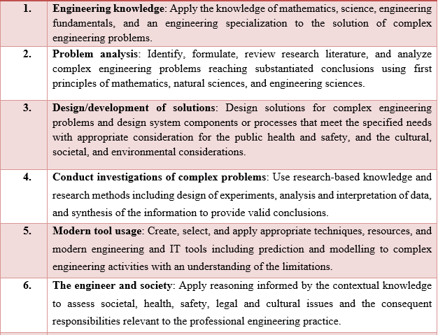
Program Outcomes

Slide 13
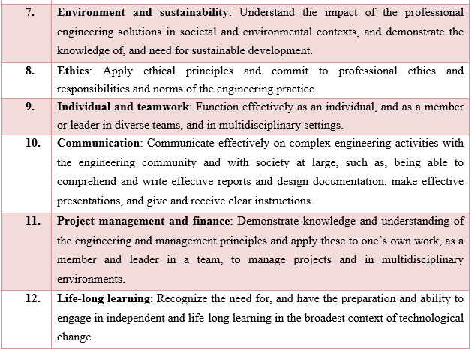
Continued….

Slide 14
CO-PO Mapping
 | PO1 | PO2 | PO3 | PO4 | PO5 | PO6 | PO7 | PO8 | PO9 | PO10 | PO11 | PO12
CO1 | 3 | 3 | 2 | 1 | - | - | - | - | - | - | - | -
CO2 | 3 | 2 | 1 | - | - | - | - | - | - | - | - | -
CO3 | 3 | 3 | 2 | 1 | - | - | - | - | - | - | - | -
CO4 | 3 | 3 | 2 | 1 | - | - | - | - | - | - | - | -
CO5 | 3 | 2 | 1 | - | - | - | - | - | - | - | - | -
CO1: Determine the power series expansion of the function and evaluate indeterminate forms
CO2: Apply the method of Eigen values and Eigen vectors to solve system of first order differential equations
CO3: Determine surface area and volumes of revolution by using reduction formulae and tracing of curves
CO4: Analyze the extreme values of the multivariable function and determine potential functions for irrotational force fields
CO5: Apply different methods to solve first and higher order linear ordinary differential equations.
1 | Knowledge
2 | Analysis
3 | Design/Development
4 | Conduct Investigation
5 | Modern Tool Usage
6 | The Engineer and Society
7 | Environment and Sustainability
8 | Ethics
9 | Individual and Team Work
10 | Communication
11 | project Management and Finance
12 | Life Long Learning

Slide 15
Target Levels
Target set for the session 2020-2021 ODD Semester (Current Academic Year)
70% of students scoring >=60% | 3
60% of students scoring >=60% | 2
50% of students scoring >=60% | 1

Slide 16
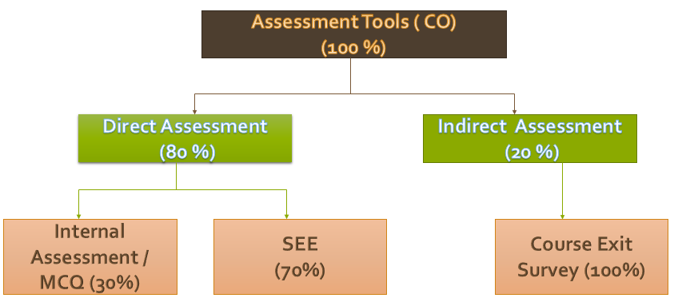
Assessment Process
Three Internal Assessments will be conducted which includes 5 marks of MCQ
The average of best two is taken and will be scaled to 30 marks
Semester end examination is conducted for 70 marks.
To pass in the course as per the regulations of University, students shall secure a minimum of 40 marks (IA and SEE together) provided SEE marks>=28

Slide 17
Applications of Calculus
Calculus is used to improve the architecture not only of buildings but also of important infrastructures such as bridges.
In Electrical Engineering, Calculus (Integration) is used to determine the exact length of power cable needed to connect two substations, which are miles away from each other.
Credit card companies use calculus to set the minimum payments due on credit card statements at the exact time the statement is processed by considering multiple variables such as changing interest rates and a fluctuating available balance.
A graphics artist uses calculus to determine how different three-dimensional models will behave when subjected to rapidly changing conditions. It can create a realistic environment for movies or video games.

Slide 18
Thank you!
Dr Kokila Ramesh

